Slide 1
AgriSupport: Harnessing Artificial Intelligence for Agricultural Progress
Review – 0
Rahul Sandireddy – (20BCE1001)
Submitted To
Dr. Vergin Raja Sarobin M

Slide 2
INTRODUCTION
Area of the Project

Slide 3
Introduction
AI in agriculture has the potential to revolutionize the way crops are grown and managed. AI can help farmers optimize crop yields, make more informed decisions about crop selection, and predict crop prices.
AI can also aid in disease detection and management, preventing diseases from spreading and causing significant damage to crops. Additionally, AI can assist with precision farming, helping farmers to optimize the use of resources such as water and fertilizer.
By providing farmers with accurate and real-time data, AI can help farmers to make more informed decisions, resulting in increased profits and reduced costs.
The integration of AI in the agricultural sector can lead to more efficient, sustainable, and precise farming practices, ultimately resulting in more food production with less resources. To solve major predicaments in the agriculture we have designed an Intelligent system which uses artificial intelligence and machine learning to optimize crop yields, improve crop selection and management, and aid in disease detection.

Slide 4
Problem Statement
Crop failure due to soil infertility
Crop Diseases
Unpredictable Crop prices
Agriculture Large language Model

Slide 5
Motivation
Agriculture is the backbone of many economies, and farmers play a crucial role in feeding the world's population. However, farmers face numerous challenges, such as soil degradation, water scarcity, and changing weather patterns, which have a direct impact on crop yields. The increasing demand for food also puts pressure on farmers to maximize their crop yields while also keeping costs under control.
The integration of soil fertility analysis and machine learning algorithms aims to tackle these challenges by providing farmers with personalized crop recommendations based on their soil type and fertility. The system will analyse soil fertility data and provide recommendations for crops that are best suited to the
Additionally, the system will incorporate disease detection and fertilizer recommendation to help farmers identify and address potential issues before they have a significant impact on crop yields. Furthermore, the crop price prediction aspect of the system will provide farmers with valuable information on market trends, allowing them to make informed decisions about when to sell their crops and at what price.

Slide 6
Abstract
AgroTech project explores the application of AI in agriculture, specifically focusing on crops. The use of AI in agriculture has the potential to revolutionize the way crops are grown and managed. This project focuses on three specific applications of AI in agriculture: crop recommendation based on soil fertility, real-time crop price prediction, and crop disease detection.
Overall, this research demonstrates the potential of AI to improve crop yields, optimize crop selection and pricing, and aid in disease management in agriculture. These findings can help farmers make more informed decisions, resulting in increased profits and reduced costs. These applications of AI have the potential to significantly impact the agricultural industry, leading to more efficient and sustainable farming practices.

Slide 7
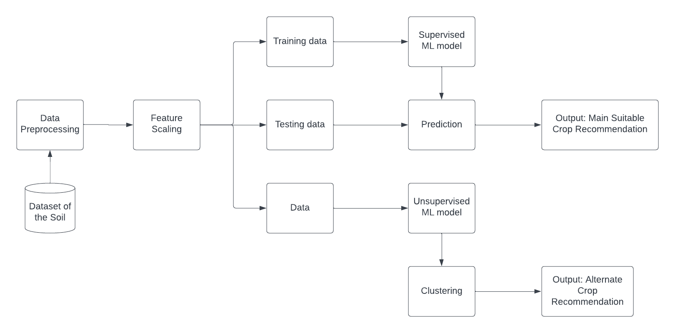
Proposed Architecture

Slide 8
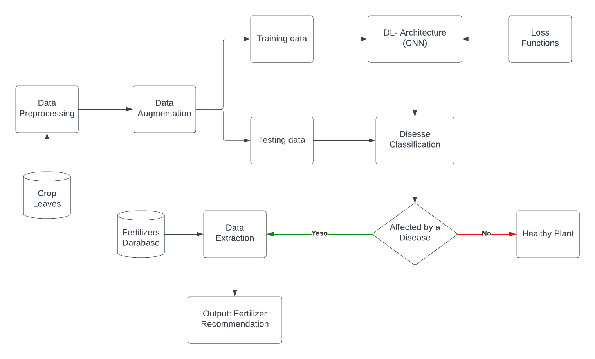

Slide 9
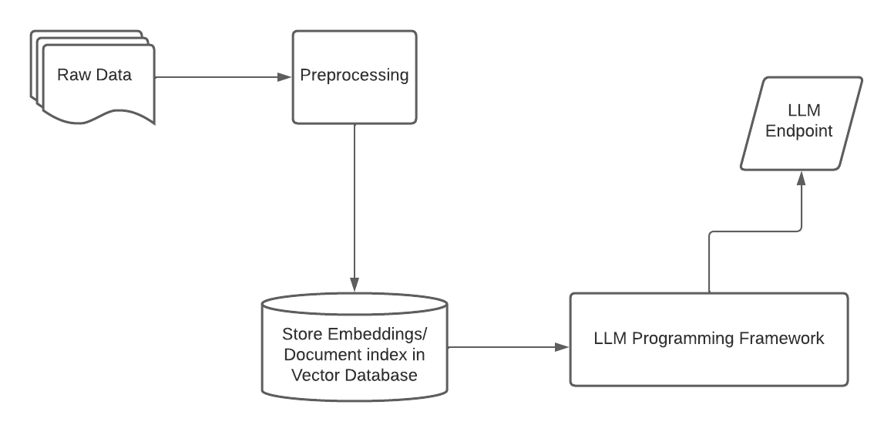

Slide 10
THANK YOU!

